Slide 1
Adobe®
An Introduction to the OASIS Reference Model for Service Oriented Architecture (SOA)
Duane Nickull
dnickull@adobe.com
Chair – OASIS SOA-RM TC

Slide 2
Agenda (< 20 minutes)
Why a Reference Model for SOA might be a good thing.
Highlight work of OASIS SOA Reference Model Technical Committee.
Role of Reference Models in architecture.
Q&A

Slide 3
When people talk about SOA…
Would be nice if we had consensus on what SOA is.
Thoughts:
  SOA is an architectural paradigm (model). So how do we express it as architecture?
  Is it sufficiently different from other types of architecture? If SOA is “X”, what is not SOA?
  SOA does not specifically mean Web Services although WS is a popular implementation of SOA.
OASIS Service Oriented Architecture Reference Model Technical Committee (SOA RM TC):
  Reference Model to captures core tenets, axioms of SOA in an ABSTRACT model.
  To be used as template for architecture (explain – cars, houses etc).

Slide 4
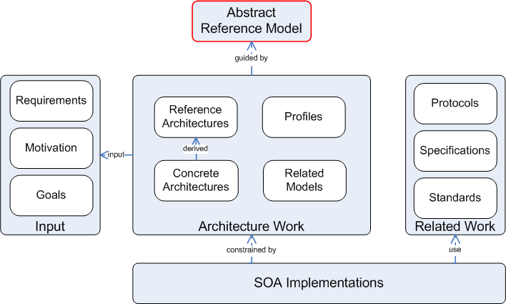
Is SOA more than just architecture?
SOA Framework
Notes:
What guides it?

Slide 5
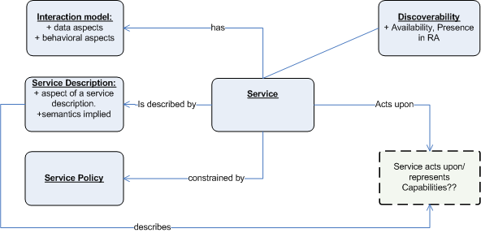
Concept Map – OASIS SOA Reference Model
DRAFT – may change
Notes:
Show in a similar fashion the base reference model decoupled from implementation. Reasons why it differs is…
Service Description has relationship to contract.

Slide 6
Core Concepts of SOA
Service: A service is a set of behaviors accessible via a prescribed interface.
Service Description: Artifact declaring all relevant aspects of a service required by potential service consumers.
Discoverability: The facet of how a Service communicates its’ existence, availability and other details to all potential consumers on a fabric.

Slide 7
Core Concepts of SOA
Data and Behavioral Model: The abstract data model used by a service and the behavioral model associated with its’ use.
Policy: A set/range of constraints imposed on any entity when invoking a service. If ignored, the invocation request may be denied.
Capabilities (no consensus on whether this is core part of Model as of August 2005): The effects of invoking the service. The thing the service acts upon.

Slide 8
SOA & Business Process Management
Process &
Orchestration
Tier
BPM Executable
BPM Executable
BPM Executable
BPM Executable
BPM Executable
Human
Resources
Grants
Management
Customer
Service
Budgeting and
Forecasting
Acquisition
Service
Oriented
Tier
Service
Service
Service
Service
Service
Business &
Application
Tier
Server
Server
Server
Server
Data
Server
Server
Data
Courtesy Booz Allen Hamilton – http://www.bah.com

Slide 9
About Reference Models

Slide 10
Reference Model
A reference model is an abstract framework for understanding significant relationships among the entities of some environment, and for the development of consistent standards or specifications supporting that environment.
A reference model is based on a small number of unifying concepts and may be used as a basis for education and explaining standards to a non-specialist.
A reference model is not directly tied to any standards, technologies or other concrete implementation details, but it does seek to provide a common semantics that can be used unambiguously across and between different implementations.

Slide 11
Where would the housing industry be?
Implied reference model means architects know their blueprints will be understood and that manufacturer’s are ready to supply the parts needed.
“Palette” of items to work from in model:
  Doors, Windows, frames, Gyproc, Flooring, Plumbing etc.
  Vendors are aligned with architects views. Entire industry wins!

Slide 12
Reference Models are Abstract
The RM for “house” is not specific enough for a contractor to build a house.
The RM aides the architect to make a specialized architecture for a specific set of requirements, using elements of the RM.
Most industries have an implied or explicit reference model:
  Automobile, Aerospace, Logistics, Bicycle, Skis, etc.

Slide 13
References
OASIS SOA RM TC - http://www.oasis-open.org/committees/tc_home.php?wg_abbrev=soa-rm
Thank you – Duane Nickull, dnickull@adobe.com

Slide 14


Slide 15


Slide 16
OASIS SOA RM TC
(optional slides)

Slide 17
OASIS SOA Reference Model TC
Chartered February 2005
Problem to be solved:
  "Service Oriented Architecture" (SOA) as a term is being used in an increasing number of contexts and specific technology implementations, sometimes with differing or conflicting understandings of implicit terminology and components.
  The proposal to establish a Reference Model is intended to encourage the continued growth of specific and different SOA implementations whilst preserving a common layer that can be shared and understood between those or future implementations.

Slide 18
OASIS SOA Reference Model TC
Purpose:
  The SOA-RM TC will deliver a Service Oriented Architecture Reference Model (SOA-RM).
  The TC may also create sub-committees, promotional material, liaisons or other promulgation of the TC's work, in order to promote the use of the SOA Reference Model.
  May help vertical industries develop SOA for their requirements.

